Slide 1
Smart Clock
Ridwan Bahari
Intern SMD GMAX CAE I 9

Slide 2
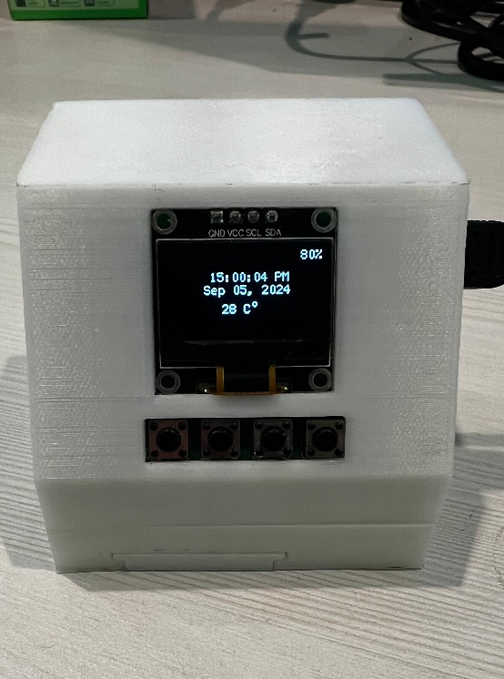
Introduction
The Smart Clock is an intelligent alarm clock that can be controlled by voice, hand or BLE. It not only displays the time but also functions as a voice command with features like playing music and controlling other devices. The objective of this project is to develop adaptive smart technologies, including improved user experience, multiple command options, and the ability to detect air quality.

Slide 3
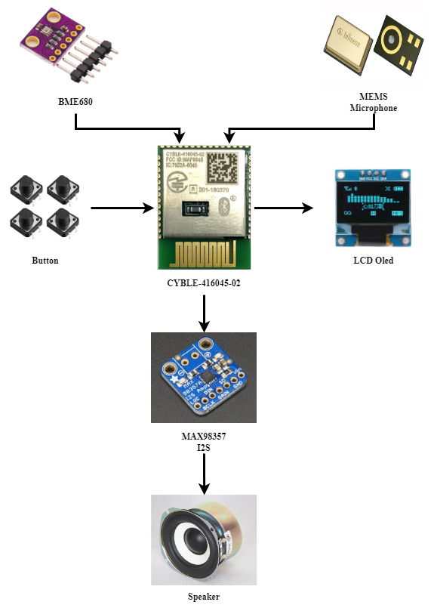
Hardware

Slide 4
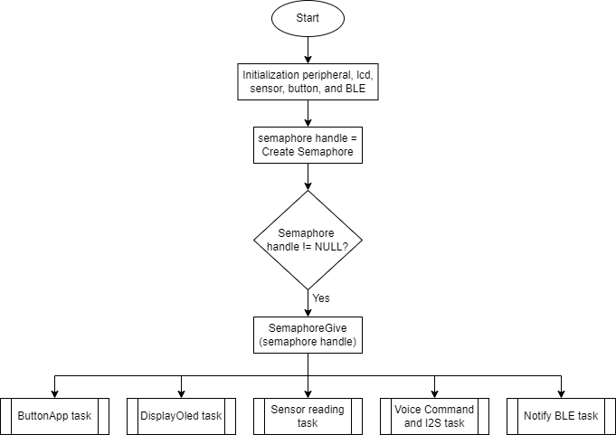
Main system

Slide 5
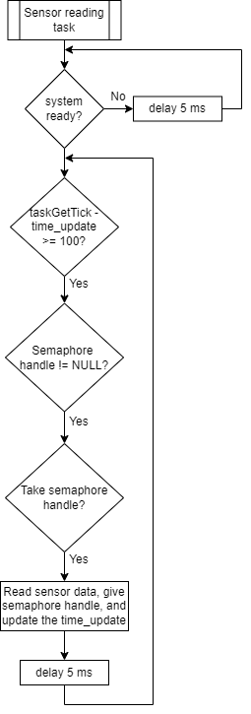
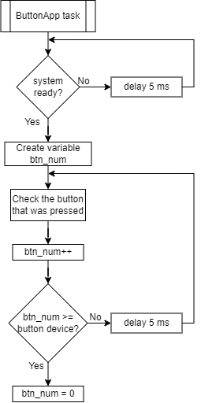
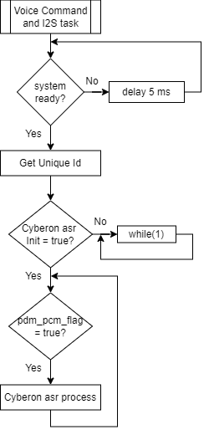
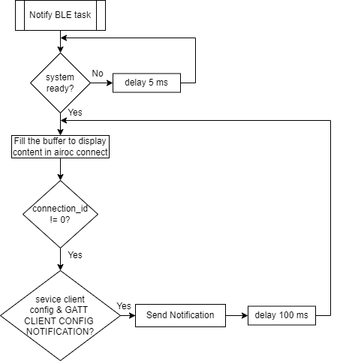
Smart Clock task

Slide 6
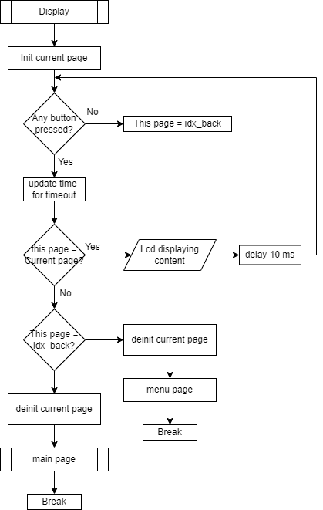
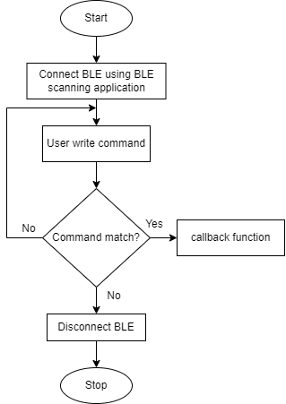
Interfacing and BLE mode

Slide 7
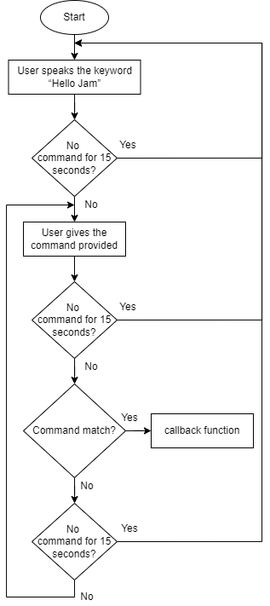
Voice command

